Slide 1
COMP1820
Introduction to Compilers
Lecture 1
Overview of Compilers
011000101

Slide 2
Learning outcomes
Following this lecture you should
Know what compilers are and how/where are they used
Understand the concept “language processing system”
Understand how a language processing system operates
Recognise the phases of a compiler
Construct basic syntax trees
2

Slide 3
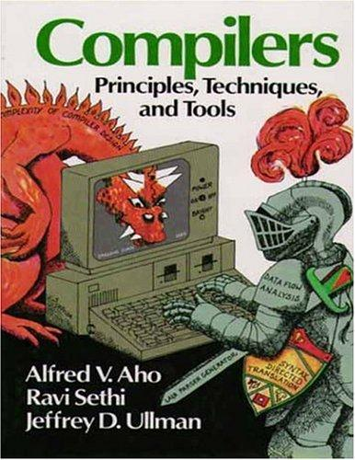
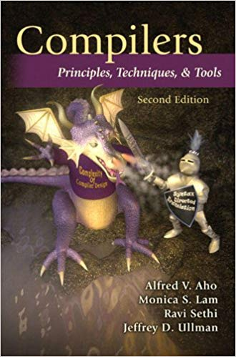
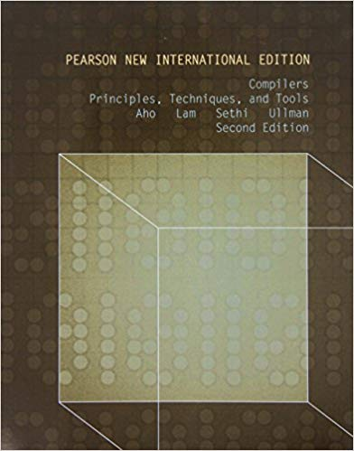
Source
Prescribed text book
Aho, A. V., Lam, M. S., Sethi, R. & Ullman, J. D., 2014. Compilers - Principles, Techniques and Tools. Essex: Pearson Education Limited
Seen as definitive book on compilers – first published 1986
Numerous editions
Note: You don’t need to buy this book, there are many copies in the library and the slides/notes/lectures should be enough to complete this course, as we will only look at a subset of the content
3
Notes:
https://getyarn.io/yarn-clip/b27fc564-6fc9-4ebc-a2e0-0977852e7931
Clip from Hackers - 1995

Slide 4
Compilers
Why study this?
It will make you a better programmer
Code more naturally
Better understanding of underlying structures
Explore Computer Science concepts that are also useful on their own
State machines
Language constructs
Stacks
4

Slide 5
Compilers
What is a compiler?
A translator is a generic term that could refer to a compiler, assembler, or interpreter; anything that converts code from one language into another
A compiler is a software system that can read a program in one high level language and translate it into another low level language to create an executable
An assembler translates low level code into machine code instructions
An interpreter is a computer program that directly executes instructions written in a programming language
5
Notes:
https://www.geeksforgeeks.org/language-processors-assembler-compiler-and-interpreter/

Slide 6
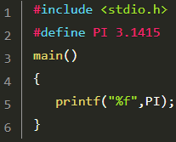
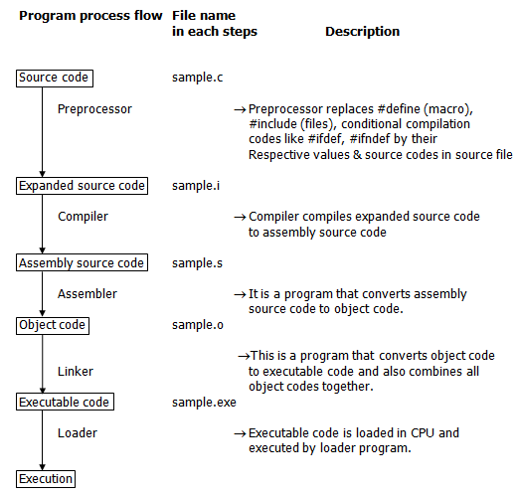
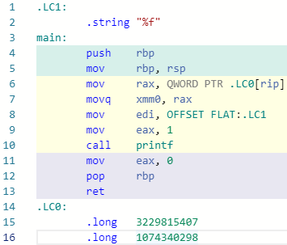
Compilers
Language processing system
Several programs required to create an executable target program
source program
Preprocessor
modified source program
Compiler
target assembly program
Assembler
relocatable machine code
library files
relocatable object files
(Compiler Explorer, 2019)
Linker/Loader
target machine code
(Fresh2Refresh.com, 2019)
6

Slide 7
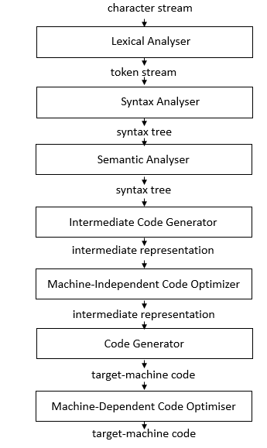
Compilers
Phases of a compiler
position = initial + rate * 60
<id,1> | <=> | <id,2> | <+> | <id,3> | <*> | <60>
We will look at a subset of the content
=
Symbol Table
Syntax Analyser
<id,1>
+
1 | position | …
2 | initial | …
3 | rate | …
… | … | …
<id,2>
*
<id,3>
60
=
t1 = inttofloat(60)
t2 = id3 * t1
t3 = id2 + t2
id1 = t3
<id,1>
+
<id,2>
*
<id,3>
inttofloat
t1 = id3 * 60.0
id1 = id2 + t1
60
LDF R2, id3
MULF R2, R2, #60.0
LDF R1, id2
ADDF R1, R1, R2
STF id1, R1
7
Notes:
Textbook p5-11

Slide 8
Compilers
Syntax Trees
Abstract syntax trees (or syntax trees) are data structures widely used in compilers to represent the structure of program code.
For now we will consider only mathematical expressions (assignments that can be part of code).
We will consider syntax trees again, in more detail, in a future lecture.
8

Slide 9
Compilers
Simple Syntax Trees
Consider the two types of operations in basic mathematics:
Binary Operators (e.g. + as in 3 + 4)
Unary Operators (e.g. - as in -3)
+
3
4
-
3
9

Slide 10

Compilers
Syntax Trees – Example 1
Create a syntax tree for: $x=y+2$
=
x
+
y
2
10

Slide 11

Compilers
Syntax Trees – Example 2
Create a syntax tree for: $x=2y+z(−y+4)$
=
x
+
*
*
2
y
z
+
-
4
y
11

Slide 12


Compilers
Syntax Trees – Example 3
Create a syntax tree for: $x=\frac{−b+\sqrt{b−4c}}{8a}$
=
x
/
+
*
-
$$\sqrt{..}$$
8
a
b
-
b
*
4
c
12

Slide 13
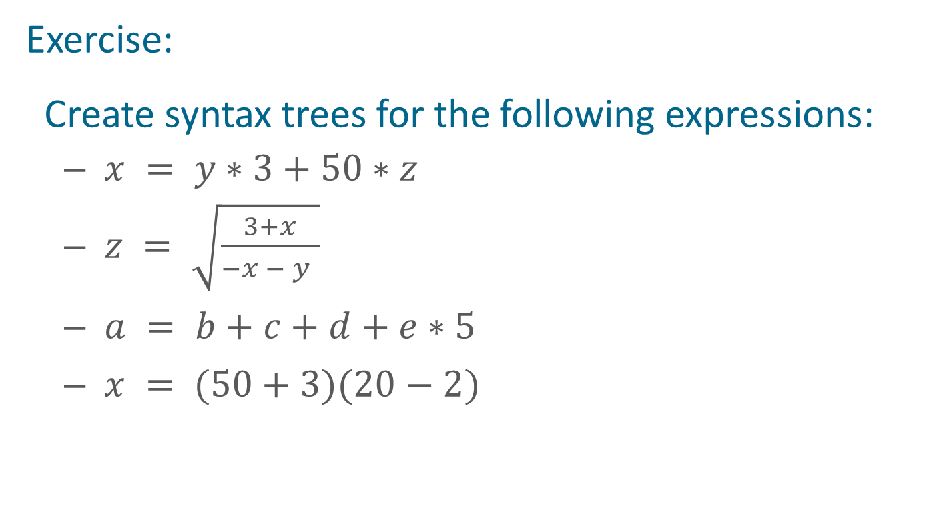
Compilers
Syntax Trees
Exercise:
Create syntax trees for the following expressions:
$x = y∗3+50∗z$
$z = \sqrt{\frac{3+x}{−x − y }}$
$a = b+c+d+e∗5$
$x = (50+3)(20−2)$
13

Slide 14
Compilers
The Science behind building a Compiler
Compiler design is full of beautiful examples where complicated real-world problems are solved by abstracting the essence of the problem mathematically.
As a natural part of this course we’ll look at the mathematics and the theory of computation that spawned the field of Computer Science and machines as we know it.
We will look at how these theories are used to construct compilers.
We will look at many real world examples of how these models are used in problems solving.
14

Slide 15
Not all problems are solvable
Alan Turing’s famous paper rejection
Below is the assessment made by a reviewer of Turing's 1936 paper:
A. TURING - “On Computable Numbers, with an Application to the Entscheidungsproblem.”
This is a bizarre paper. It begins by deﬁning a computing device absolutely unlike anything I have seen, then proceeds to show—I haven’t quite followed the needlessly complicated formalism—that there are numbers that it can’t compute. As I see it, there are two alternatives that apply to any machine that will ever be built: Either these numbers are too big to be represented in the machine, in which case the conclusion is obvious, or they are not; in that case, a machine that can’t compute them is simply broken! Any tabulating machine worth its rent can compute all the values in the range it represents, and any number computable by a function—that is, by applying the four operations a number of times—can be computed by any modern tabulating machine since these machines—unlike the one proposed here with its bizarre mechanism—have the four operations hardwired. It seems that the “improvement” proposed by Turing is not an improvement over current technology at all, and I strongly suspect the machine is too simple to be of any use. If the article is accepted, Turing should remember that the language of this journal is English and change the title accordingly.
15

Slide 16
Not all problems are solvable
Example: Post Correspondence Problem
Dominos
B
A
CA
ABC
CA
AB
A
C
We need to find a sequence of dominos such that the top and bottom strings are the same. We can use any number of each domino
Solution:
A
B
CA
A
ABC
AB
CA
A
AB
C
ABCAAABC
ABCAAABC
16

Slide 17
Solvable Problems
Chomsky Hierarchy
Described by Noam Chomsky in 1956
Unrestricted Grammar
(Recognised by
Turing Machine)
Context Sensitive
Grammar
(Accepted by Linear
Bound Automata)
Context Free Grammar
(Accepted by
Pushdown Automata)
Regular Grammar
(Accepted by
Finite Automata)
17

Slide 18
Learning outcomes
From this lecture
Know what compilers are and how/where are they used
Understand the concept “language processing system”
Understand how a language processing system operates
Recognise the phases of a compiler
Construct basic syntax trees
18

Slide 19
Sources
Aho, A. V., Lam, M. S., Sethi, R. & Ullman, J. D., 2014. Compilers - Principles, Techniques and Tools. Essex: Pearson Education Limited
Compiler Explorer. Compiler Explorer. Retrieved August 22, 2019, from Godbolt.org.
Fresh2Refresh.com. C Preprocessor Directives. Retrieved August 22, 2019, from C Programming Tutorial: https://fresh2refresh.com/c-programming/c-preprocessor-directives/
19

